Slide 1

SQL Final Project
Richard Liu
BAX 421

Slide 2

Brief Overview
League of Legends –ARAM Mode
how different champions perform across various regions – EUW, NA, KR, JP, and TW.
Identify performance, considering factors like effectiveness in matches and popularity among players.

Slide 3
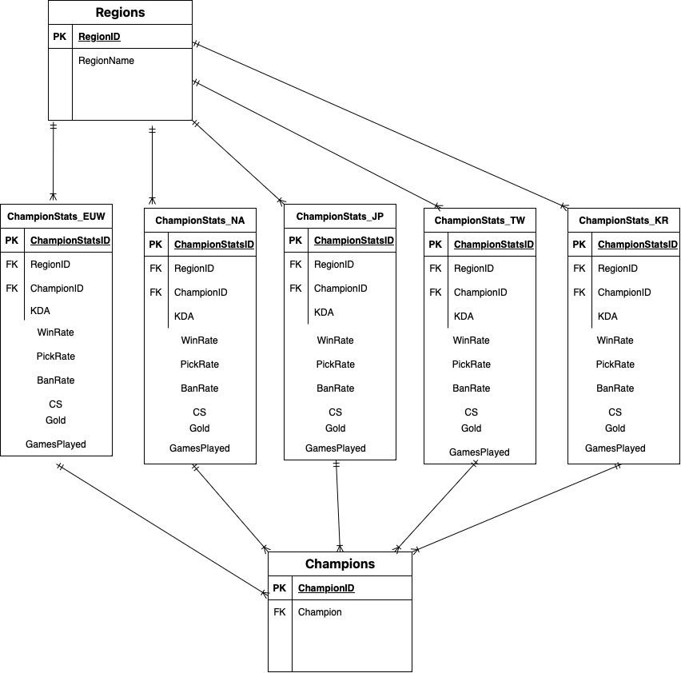
Tables
Regions - Europe, North America, Korea, Japan, Taiwan
Champions – 165 Champions
ChamptionStats_EUW
ChamptionStats_NA
ChamptionStats_KR
ChamptionStats_JP
ChamptionStats_TW

Slide 4

Business Questions

Slide 5
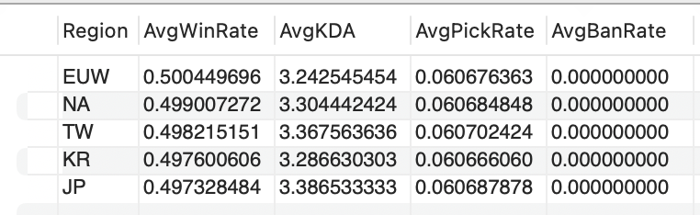
Q1: Which region has the most balanced gameplay in terms of average win rate, KDA, pick rate, and ban rate across all champions?
Observes in gameplay balance metrics across regions, identifying which region offers the most equitable play environment. Balanced metrics suggest a fair and competitive environment, crucial for player engagement and strategy diversity.
Merged data from different region-specific tables using UNION ALL.
Calculated averages for key gameplay metrics (WinRate, KDA, PickRate, BanRate) for each region.
Analyzed and compared these averages to identify the region with the most balanced gameplay.

Slide 6
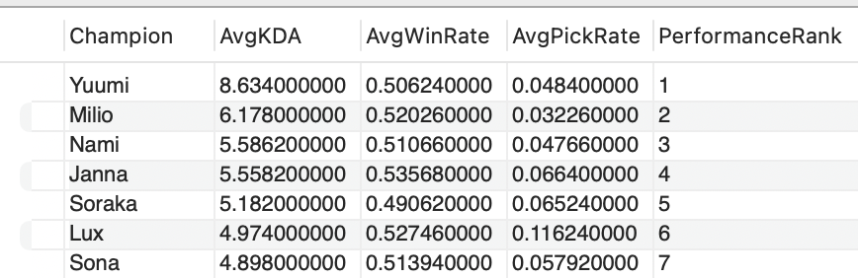
Q2 How do champions rank in terms of overall performance when considering average KDA, win rate, and pick rate across all regions?
Ranks Champions by performance, highlighting those excelling in effectiveness and popularity across regions. High-ranking champions often dictate game meta, influencing player strategies and game balance.
Aggregated and combined champion performance data across regions.
Calculated average KDA, WinRate, and PickRate.
Applied RANK() to order champions based on these average metrics, emphasizing overall performance.

Slide 7
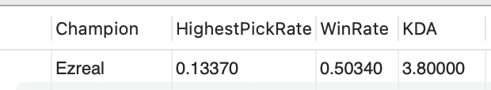
Q3 Which champion is most favored across all regions, and how does this preference correlate with their win rate and KDA?
Identifies the most popular champion across regions and analyzed their win rate and KDA. The champion's high pick rate, combined with their performance metrics, can reveal much about current player preferences and the perceived strength of champions.
Gathered comprehensive data across all regions.
Identified the champion with the highest PickRate and brought in their WinRate and KDA for a holistic view of their performance.

Slide 8
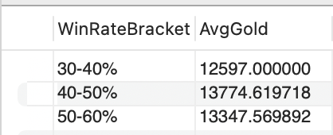
Q4 How does the average gold earned by champions in the TW region compare across different win rate brackets?
Analyzes of how average gold earnings vary across different win rate brackets for champions in the TW region. Reveals how performance (win rate) impacts resource accumulation, a key aspect of in-game strategy and champion effectiveness.
Categorized champions into win rate brackets using CASE statements in a subquery.
Calculated the average gold for each bracket to examine the relationship between win rates and economic gains.

Slide 9
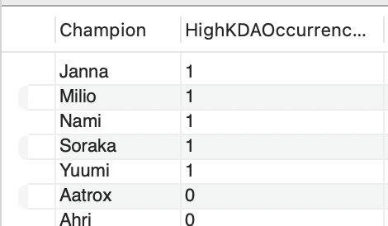
Q5 In the EUW region, which champions most frequently achieve a KDA above 5, and how does this reflect on their overall performance?
Identifies Champions in the EUW region that frequently achieve a KDA above 5, indicating consistent performance. High KDA is often a sign of significant impact in matches, and these champions may be crucial picks for players in this region.
Used a COUNT with a CASE WHEN statement to identify occurrences of high KDA for each champion.
Highlighted champions with frequent high KDA scores, suggesting consistent top performance.

Slide 10
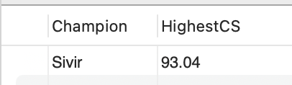
Q6 Which champion in the KR region has the highest average CS?
This highlights the champion with the highest average CS in the KR region. High CS is indicative of effective resource management and laning strength, essential for gaining strategic advantages.
Selected the maximum CS for each champion to identify the leader in this aspect, revealing who excels at farming efficiency.

Slide 11
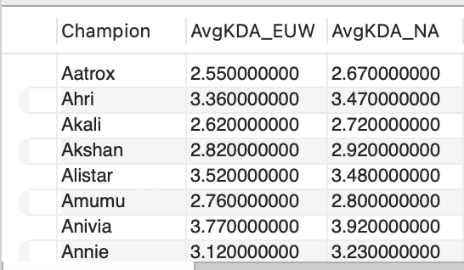
Q7 List the difference in the average KDA between champions in the EUW and NA regions.
Compares the average KDA for champions in the EUW and NA regions Highlights how regional playstyles and strategic preferences impact champion performance and effectiveness.
Combined champion data with regional stats using LEFT JOINs.
Averaged KDAs in both regions for each champion, underlining performance variations and regional gameplay styles.

Slide 12
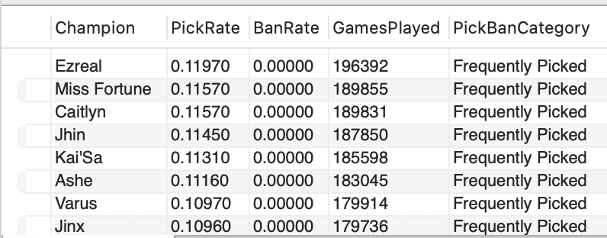
Q8 How does the pick rate of champions in the TW region correlate with their games played, and which champions are picked frequently ?
Explored the relationship between pick rate, ban rate, and games played for champions in the TW region. This insight can inform players about strategic and popular picks.
Focused on TW region, examining correlations between pick rate and total games played.
Used CASE WHEN to categorize champions based on their pick and ban rates, highlighting those often picked.

Slide 13
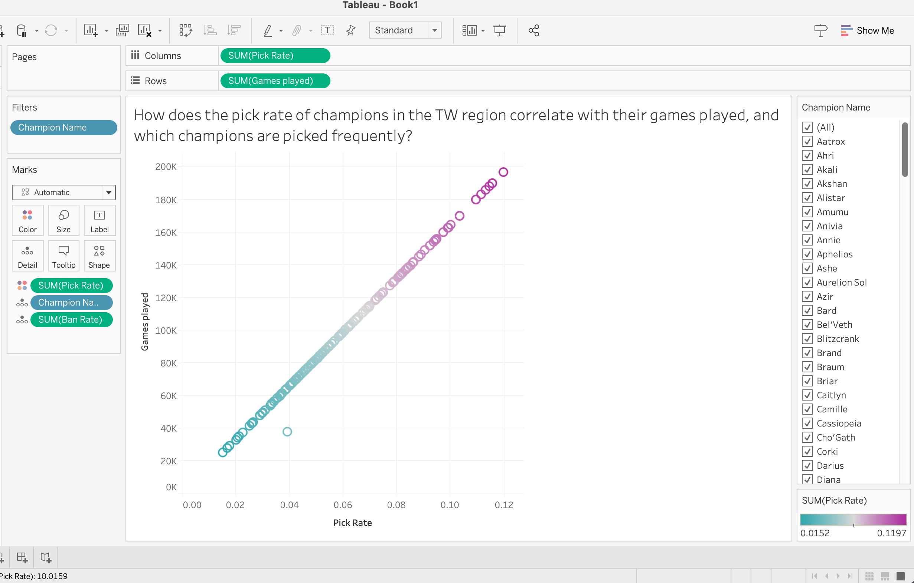
Data Visualizations

Slide 14
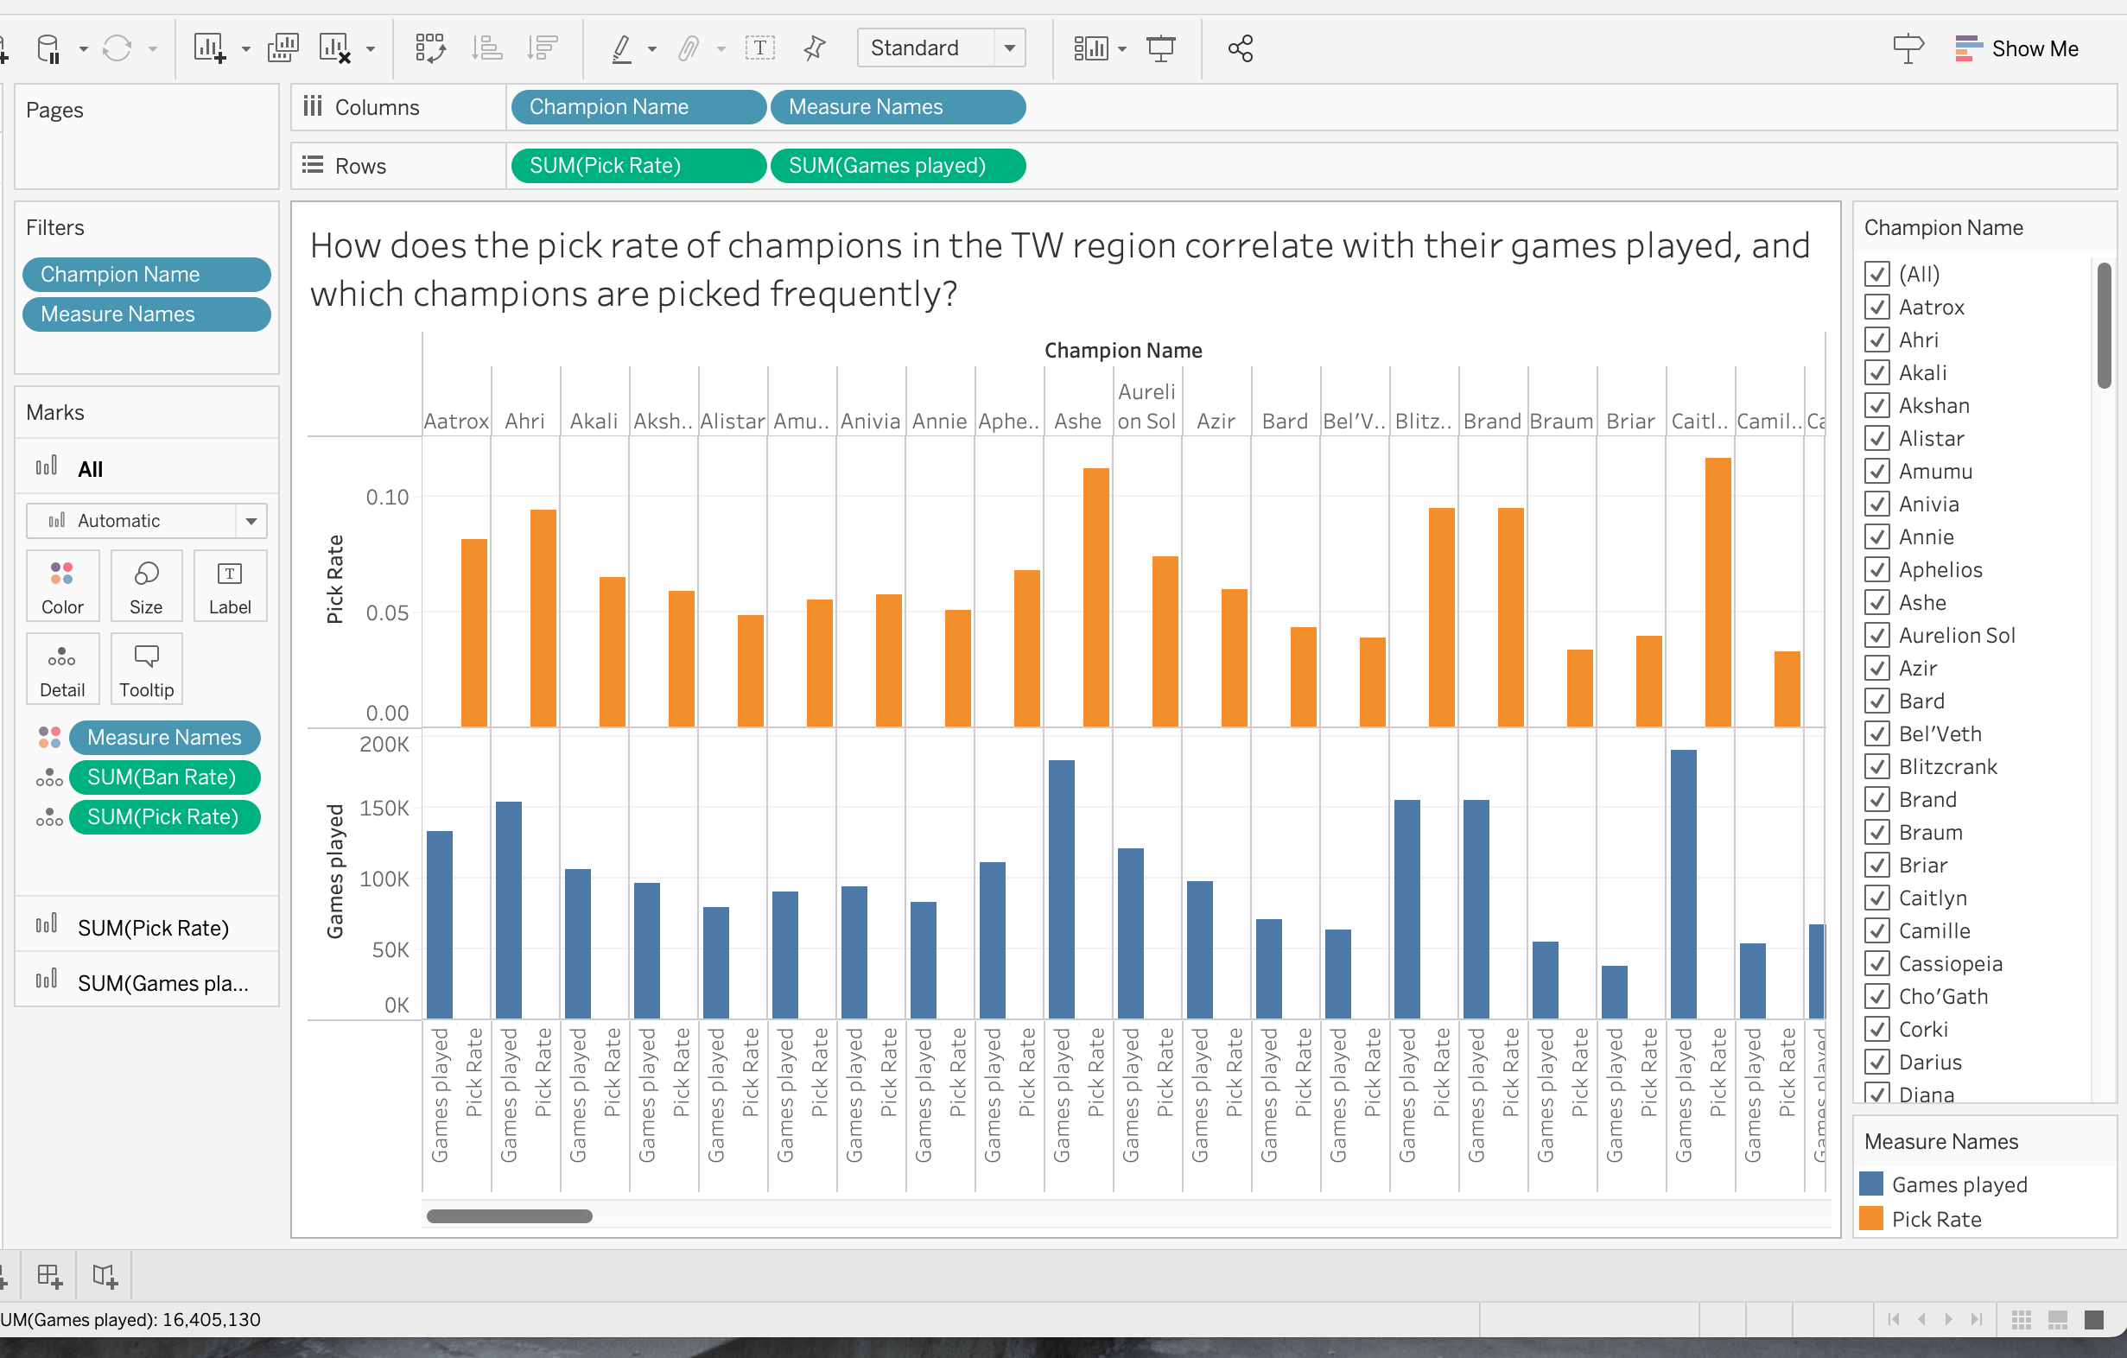
Data Visualizations

Slide 15
Thank You!

